Slide 1
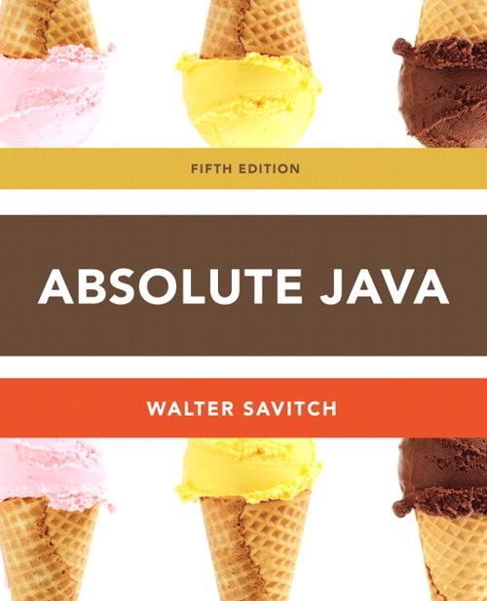
Chapter 3
Branching Mechanism
Section 3.1
Slides prepared by Rose Williams, Binghamton University
Kenrick Mock, University of Alaska Anchorage

Slide 2
Flow of Control
As in most programming languages, flow of control in Java refers to its branching and looping mechanisms
Java has several branching mechanisms: if-else, if, and switch statements
Java has three types of loop statements: the while, do-while, and for statements
Most branching and looping statements are controlled by Boolean expressions
A Boolean expression evaluates to either true or false
The primitive type boolean may only take the values true or false

Slide 3
Branching with an if-else Statement
An if-else statement chooses between two alternative statements based on the value of a Boolean expression
if (Boolean_Expression)
Yes_Statement
else
No_Statement
The Boolean_Expression must be enclosed in parentheses
If the Boolean_Expression is true, then the Yes_Statement is executed
If the Boolean_Expression is false, then the No_Statement is executed

Slide 4
Compound Statements
Each Yes_Statement and No_Statement branch of an if-else can be a made up of a single statement or many statements
Compound Statement: A branch statement that is made up of a list of statements
A compound statement must always be enclosed in a pair of braces ({ })
A compound statement can be used anywhere that a single statement can be used

Slide 5
Compound Statements
if (myScore > your Score) {
System.out.println("I win!");
wager = wager + 100;
}
else {
System.out.println
("I wish these were golf scores.");
wager = 0;
}

Slide 6
Omitting the else Part
The else part may be omitted to obtain what is often called an if statement
if (Boolean_Expression)
Action_Statement
If the Boolean_Expression is true, then the Action_Statement is executed
The Action_Statement can be a single or compound statement
Otherwise, nothing happens, and the program goes on to the next statement
if (weight > ideal)
calorieIntake = calorieIntake – 500;

Slide 7
Nested Statements
if-else statements and if statements both contain smaller statements within them
For example, single or compound statements
In fact, any statement at all can be used as a subpart of an if-else or if statement, including another if-else or if statement
Each level of a nested if-else or if should be indented further than the previous level
Exception: multiway if-else statements

Slide 8
Multiway if-else Statements
The multiway if-else statement is simply a normal if-else statement that nests another if-else statement at every else branch
It is indented differently from other nested statements
All of the Boolean_Expressions are aligned with one another, and their corresponding actions are also aligned with one another
The Boolean_Expressions are evaluated in order until one that evaluates to true is found
The final else is optional

Slide 9
Multiway if-else Statement
if (Boolean_Expression)
Statement_1
else if (Boolean_Expression)
Statement_2
else if (Boolean_Expression_n)
Statement_n
else
Statement_For_All_Other_Possibilities
. . .

Slide 10
Multiway if-else Statement
if (PercentageGrade >= 90)
System.out.println(“Your grade is A.”);
else if (PercentageGrade >= 80)
System.out.println(“Your grade is B.”);
else if (PercentageGrade >= 70)
System.out.println(“Your grade is C.”);
else if (PercentageGrade >= 60)
System.out.println(“Your grade is D.”);
else
System.out.println(“Your grade is F.”);
. . .

Slide 11
The switch Statement
The switch statement is the only other kind of Java statement that implements multiway branching
When a switch statement is evaluated, one of a number of different branches is executed
The choice of which branch to execute is determined by a controlling expression enclosed in parentheses after the keyword switch
The controlling expression must evaluate to a char, int, short, or byte

Slide 12
The switch Statement
int vehicleClass;
double tool;
. . .
switch (vehicleClass) {
case 1:
System.out.println(“Passenger car.”);
toll = 0.50;
break;
case 2:
System.out.println(“Bus.”);
toll = 1.50;
break;
case 3:
System.out.println(“Truck.”);
toll = 2.00;
break;
default:
System.out.println(“Unknown vehicle class!”);
break;
}

Slide 13
The switch Statement
Each branch statement in a switch statement starts with the reserved word case, followed by a constant called a case label, followed by a colon, and then a sequence of statements
Each case label must be of the same type as the controlling expression
Case labels need not be listed in order or span a complete interval, but each one may appear only once
Each sequence of statements may be followed by a break statement ( break;)

Slide 14
The switch Statement
There can also be a section labeled default:
The default section is optional, and is usually last
Even if the case labels cover all possible outcomes in a given switch statement, it is still a good practice to include a default section
It can be used to output an error message, for example
When the controlling expression is evaluated, the code for the case label whose value matches the controlling expression is executed
If no case label matches, then the only statements executed are those following the default label (if there is one)

Slide 15
The switch Statement
The switch statement ends when it executes a break statement, or when the end of the switch statement is reached
When the computer executes the statements after a case label, it continues until a break statement is reached
If the break statement is omitted, then after executing the code for one case, the computer will go on to execute the code for the next case
If the break statement is omitted inadvertently, the compiler will not issue an error message

Slide 16
The switch Statement
switch (Controlling_Expression) {
case Case_Label_1:
Statement_Sequence_1
break;
case Case_Label_2:
Statement_Sequence_2
break;
case Case_Label_n:
Statement_Sequence_n
break;
default:
Default_Statement Sequence
break;
}
. . .

Slide 17
The Conditional Operator
The conditional operator is a notational variant on certain forms of the if-else statement
The following examples are equivalent:
if ( n1 > n2 )
max = n1;
else
max = n2;
vs.
max = (n1 > n2) ? n1 : n2;
The expression to the right of the assignment operator is a conditional operator expression
If the Boolean expression is true, then the expression evaluates to the value of the first expression (n1), otherwise it evaluates to the value of the second expression (n2)

